Slide 1
8th AFRICA ISLAMIC FINANCE SUMMIT
TOPIC: THE ISLAMIC FINANCE ECOSYSTEM AND REGULATORY FRMEWORK FOR ISLAMIC FINANCIAL
FACILITATOR: HAMAR JAWO
SENIOR BANK EXAMINER, CENTRAL BANK OF THE GAMBIA FINANCIAL SUPERVISION DEPARTMENT
CO-FOUNDER INSTITUTE OF ISLAMIC ECONOMICS AND FINANCE (IIEF)
SENIOR LECTURER, INTERNATIONAL OPEN UNIVERSITY (IOU)
ORGANIZER: ALHUDA CIBE
VENUE: SIR DAWDA KAIRABA JAWARA CONREFENCE CENTER

Slide 2
BEGIN WITH THE END IN MIND
Introduction to Islamic financial system
Islamic Finance Ecosystem
Major difference between Conventional banking and Islamic Banking
Gambia Islamic Finance Outlook
Legal Framework
Regulatory Regimes of Islamic financial institutions
Shariah Governance aspects of Islamic financial institutions
Conclusion
References:

Slide 3
ISLAMIC FINANCIAL SYSTEM
ECONOMIC
ACTIVITIES
COMMERCIAL
CHARITABLE
(NON PROFIT)
- LOAN (QARD)
- ZAKAT
-WAQF
- SADAQAH
-TRADE
- BANKING
-FINANCE
- INVESTMENT

Slide 4
Core principles in financial transactions
Core Principles
Prohibition of Riba
Prohibition of Uncertainty
Prohibition of Injustice and Deceit
Prohibition of dealing in forbidden items / activities
Consideration of Outcome
Return is subject to risk

Slide 5
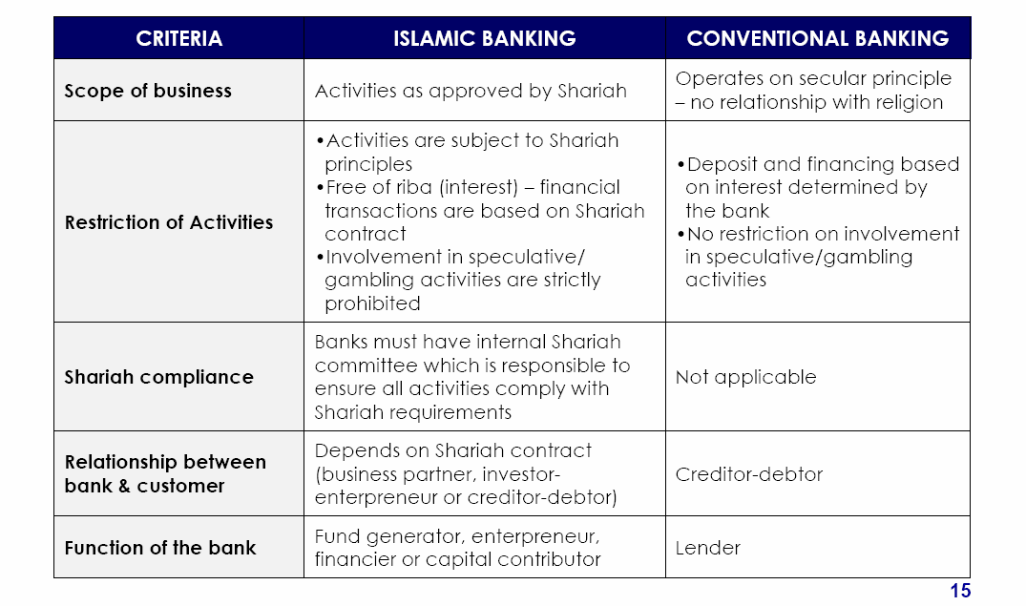
ISLAMIC VS CONVENTIONAL BANKING

Slide 6
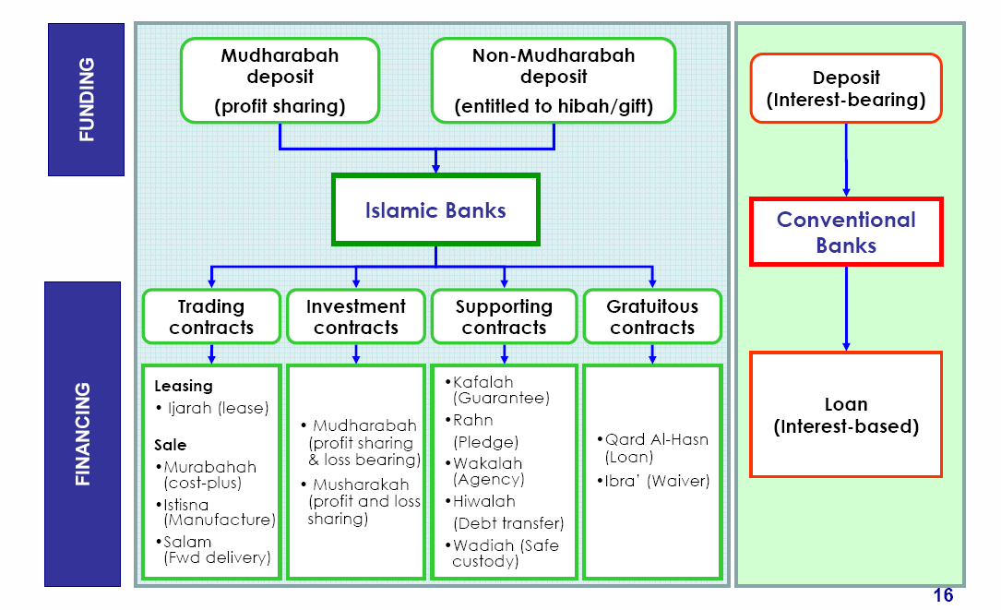
ISLAMIC VS CONVENTIONAL BANKING

Slide 7
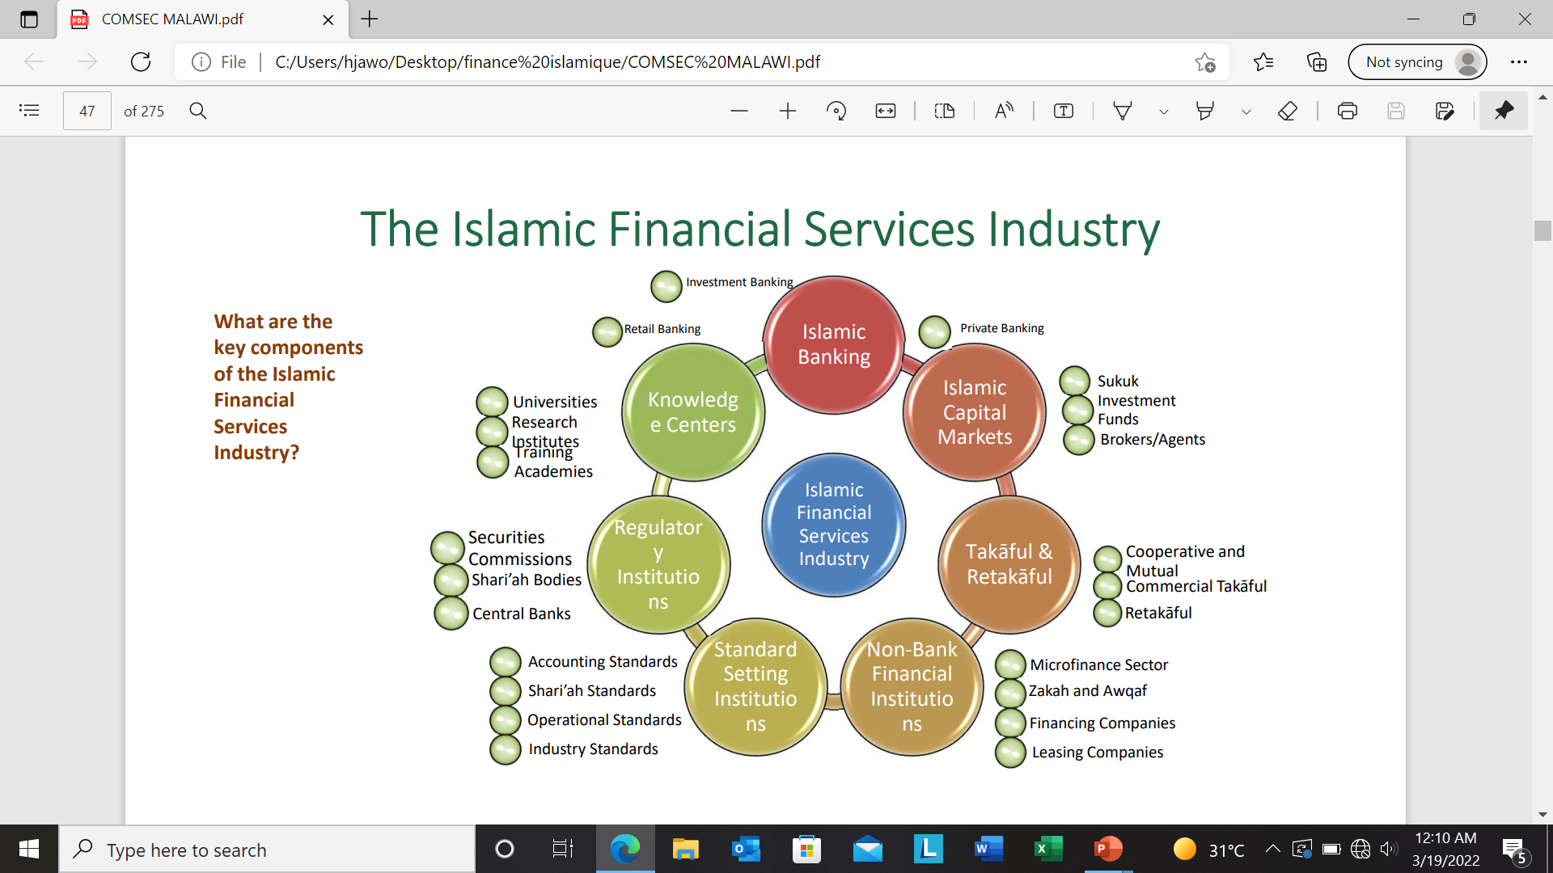
ISLAMIC FINANCE ECOSYSTEM

Slide 8
The Gambia Islamic Finance Service Industry
Islamic banking
7.2%
Islamic Capital Markets
Islamic Financial Service Industry
Takaful and Retakaful 15%
Other Financial Institutions

Slide 9
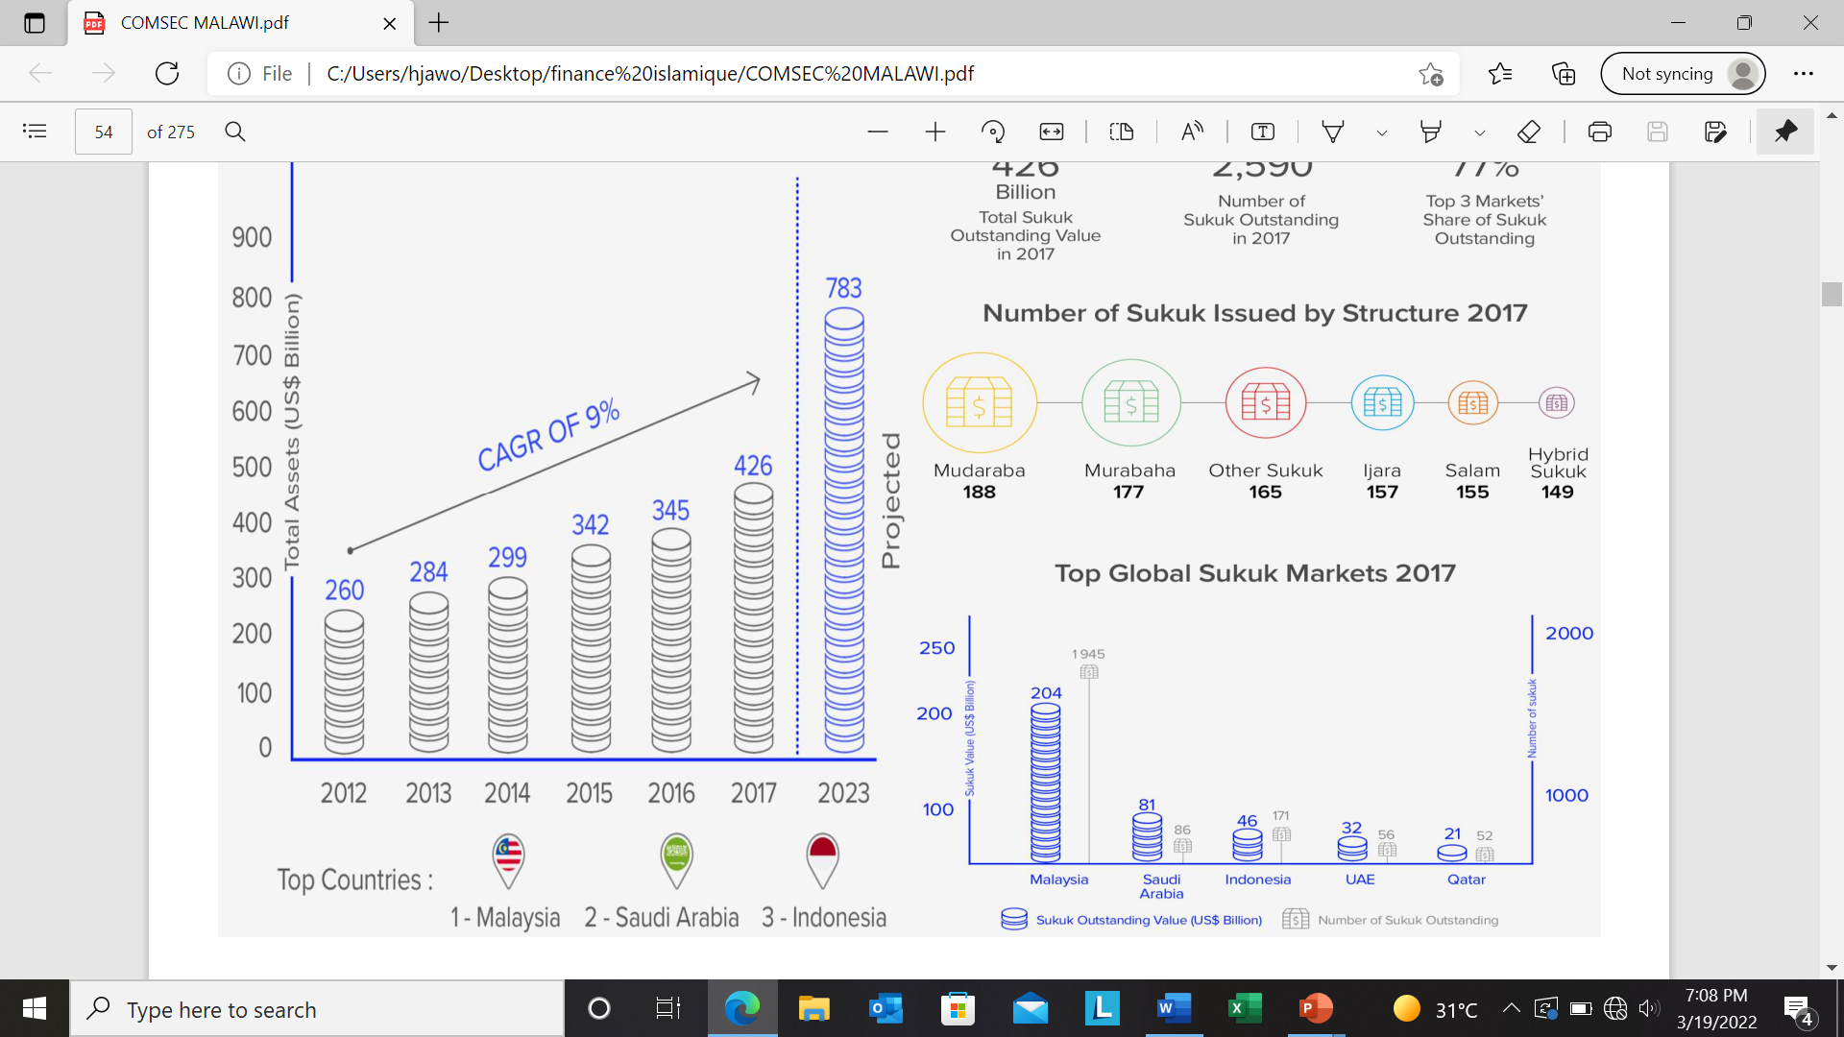
Sukuk Asset growth from (2012-2023)

Slide 10
Ijarah Sukuk can be an alternative to the conventional bond
Ijarah sukuk have proven to be a good source of funding for infrastructure beyond government muscle
GOTG through the Debt management office in collaboration with CBG, PPP and Islamic financial Institutions to explore the First Ijarah Sukuk towards the construction of Banjul/ Barra bridge
PROSPECTS OF IJARAH SUKUK

Slide 11
Steps
MODUS OPERANDI OF THE BANJUL/BARRA SUKUK INC
INVESTORS
GOTG AS SELLER
SPV
GOTG AS LEESEE

Slide 12
Steps:
- The GOTG (originator) resolves to build Banjul/Barra bridge through SPV
- The SPV raises the funds by issuing sukuk certificates to investors for the construction of the Banjul/Barra bridge
- The SPV leases the bridge to the government (as lesee) for a fixed period of time (20 years)
- SPV receives periodic rentals from the GOTG and distributes proceeds among investors
- At maturity, or on a dissolution event, the SPV sells the bridge back to the GOTG and pays capital back to investors

Slide 13
LEGAL AND SUPERVISORY FRAMEWORK FO IFIs
 | Takaful | Islamic Banking | Islamic Capital Market | Islamic Microfinance
Legal and Regulatory Framework | Insurance Amendment Act 2006 | Banking Act 2009 | Non | NFI Act 2016
Supervisory Framework | Guideline for Regulation and Supervision of Takaful Operators | Guideline for Regulation and Supervision of Islamic Banks Corporate Governance Guideline | Non | Guideline for Regulation and Supervision of Islamic Microfinance

Slide 14
SUPERVISORY FRAMEWORK FOR IFIS
Central Bank of The Gambia
xx
Guideline on IBB
Guideline on Takaful
Guideline on IMF
Guideline on ICM

Slide 15

SHARIAH GOVERNANCE OF ISLAMIC FINANCIAL INSTITUTIONS IN THE GAMBIA
-The Gambia like most West African Countries apply the Maliki Madh hab (School of thought)
-As per CBG Shariah regulation, all financial institutions must have a shariah advisory committee or board
- Due to the increasing number of IFIs, there is need to build capacity in fiqh ul Muammalat (Islamic Commercial law)

Slide 16
RESPONSIBIITIES OF SHARIAH BOARD
Certification of permissible
Financial Instruments through fatwas
(ex-anteShariah Audit)
Advise the Board of Directors and
The Management
verification of Transactions’ compliance
With Issued fatwa
(ex-post Shariah Audit)
Issue report to certify the conformity
of all Fin. Transactions with the Shariah
principles
The calculation & payment
Of Zakah
Advice on the distribution of income
& expenses among bank’s Share/holders
and IAH
Identification &
Disposal of Non-
Shariah Compliant
earnings

Slide 17
GOVERNANCE OF IFI:
CHARACTERISTICS
Islamic banks are involved in
Trade and investment
An important part of
deposit Is taken based
on mudarabah (PLS)
The operations and products
Should be compliant with
shariah
Islamic banks face risks that are unique to them
Insurance
deposit ?
Governance of IB
Capital adequacy

Slide 18
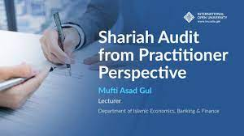
- Given the peculiarity of Islamic Financial Contracts, there should be more emphasis on Shariah Audit
- However, due to the absence of qualified Shariah Auditors, a blended approach is used to audit IFIs
SHARIAH AUDIT

Slide 19
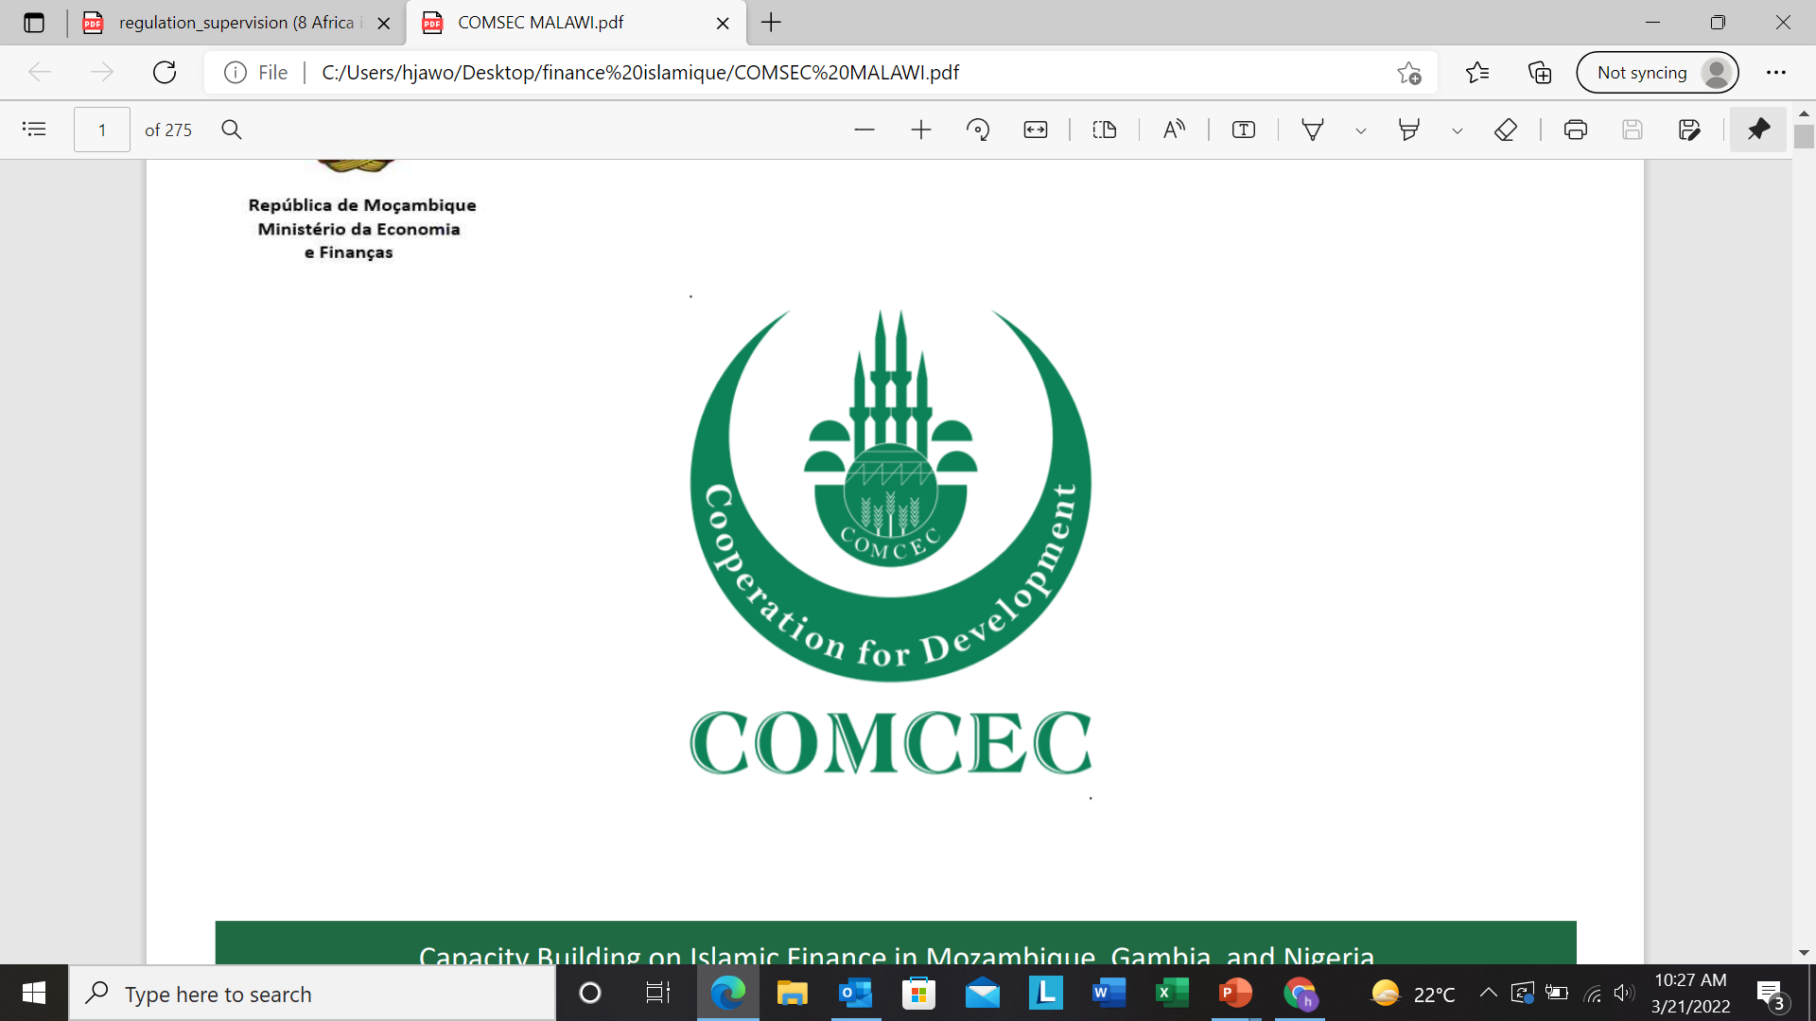
THE GAMBIA ISLAMIC FINANCE CAPACITY BUIDING PARTNERS
The Standing Committee for Economic and Commercial Cooperation of the Organization of the Islamic Cooperation (COMCEC) is the main multilateral economic and commercial cooperation platform of the Islamic world.
COMCEC has 57 Member Countries as well as 5 Observer Countries which are spread over four continents.
COMCEC PROJECT
To address the economic challenges of the Islamic Ummah and to contribute to the development efforts of the Member States.
To produce and disseminate knowledge, share experience and best-practices, develop a common understanding, and approximate policies among the Member States in line with the vision and principles of the Strategy.
To serve as the central forum for the Member States to discuss international economic and commercial issues
To study all possible means of strengthening economic and commercial cooperation among the Member States.
To draw up programs and submit proposals designed to increase the welfare of the Member States.
To ensure the overall coordination of the activities of the OIC relating to economic and commercial cooperation among the Member States.

Slide 20
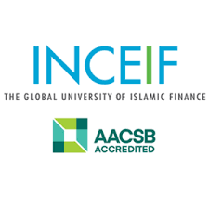
The CBG entered an MOU with INCEIF to facilitate scholarship for CBG staff to pursue Degree programs in Islamic Finance.
My learned brother Mr. Karamo Sawaneh is a graduate of INCEIF, he is the co founder of Equity Solutions, an Islamic Finance consulting firm

Slide 21

WEST AFRICAN INSTITUTE FOR FINANCIAL AND ECONOMIC MANAGEMENT
-In 2016, WAIFEM resolved to introduce a course on non-interest Banking Supervision
-This was necessitated by the growing number of Islamic banks and other financial Institutions in the region
- Capacity in cross border supervision on Islamic Financial institutions

Slide 22

MANAGEMENT DEVELOPMENT INSTITUTE (MDI)
Since 2016, the MDI has conducted several capacity building trainings on Islamic banking, Shariah Compliance, Takaful, Risk Management of IFIs, Fintech etc
The Institution has partnered with major Islamic financial institutions to start offering Certificate and Diploma courses on Islamic Finance

Slide 23

The Network of Islamic Finance Professionals – The Gambia
Membership
Diploma and other Qualification in IF
With Baechelors in Islamic Finance
With Masters or Studying Masters Degree in Islamic Finance
With PhD or Currently Studying PhD in IF
37
15

Slide 24


ISLAMIC FINANCE KNOWLEDGE PROVIDERS (ACADEMIC AND PROFESSIONAL)
Bachelors in Islamic Finance
Bachelors in Islamic Economics Finance

Slide 25
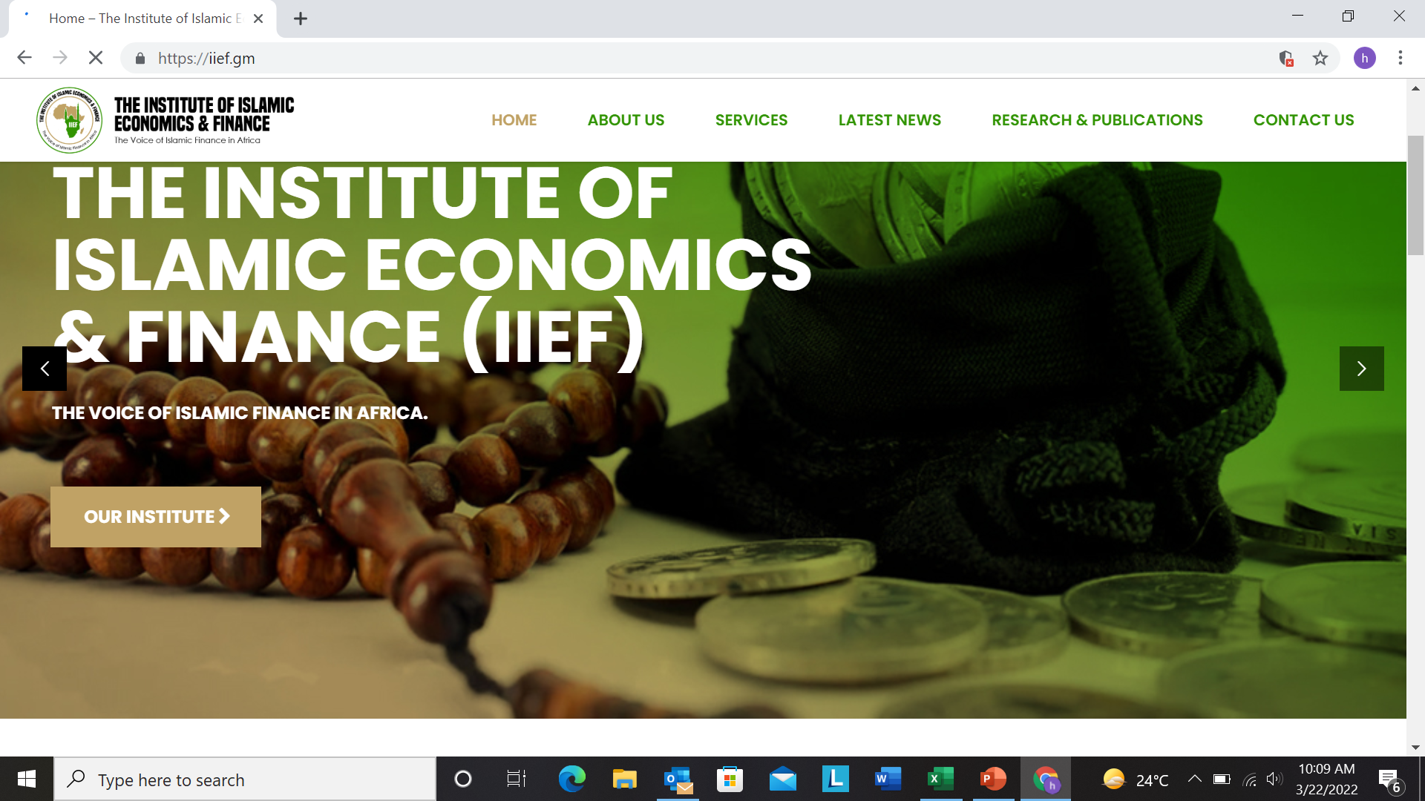
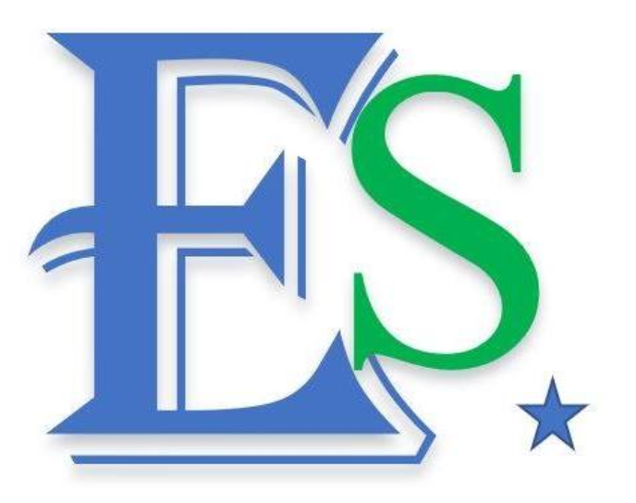
ISLAMIC FINANCE KNOWLEDGE PROVIDERS (PROFESSIONAL TRAINING AND CONSULTANCY)
IF Training and Consulting Firm
IF Training and Consulting Firm

Slide 26

PART II
REGULATORY FRAMEWORK FOR ISLAMIC BANKS

Slide 27
ISLAMIC BANKING REGULATION
Why Regulate
What to Regulate
How to Regulate

Slide 28
Differences of Islamic finance model in various jurisdictions are meant to suit local requirement
Bahrain
Pakistan
Sudan
UAE
Malaysia
SYSTEM
Single
Single legislation covers both Islamic & conventional banking
Comprehensive regulatory framework for Islamic banks
Shariah supervisory committee of individual Islamic banks
Single
National aspiration to have full-fledged Islamic
Banking Business Regulation Act
Shariah advisor of individual Islamic banks
Shariah Supervisory Board (Bank of Sudan)
Dual
Existence of dual financial system is hard-corded in Central Banking Act 2009
Dedicated Law/ Act to address Islamic finance
  Islamic Banking Act 1983
  Takaful Act 1984
  Government Funding Act 1983
Shariah advisor of individual Islamic banks
Shariah Advisory Council (SAC) of Bank Negara Malaysia
Single
Single legislation with specific provision to address Islamic banking operation
Shariah advisor of individual Islamic banks
Shariah Board of State Bank of Pakistan
Single
Single legislation covers both Islamic & conventional banking (Federal Law)
Takaful –specific law is introduced (2010)
Shariah committee of individual Islamic banks
Shariah supervisory (Ministry of Islamic Affairs)
LEGAL
SHARIAH GOVERNANCE STRUCTURE
Notes:
UAE (Islamic banking: Federal Law No.6 of 1985)

Slide 29
No “one-size-fits-all” approach, but key elements should be considered in developing legal & regulatory framework for Islamic finance…
1
Understand the Fundamental
Shariah as the backbone of Islamic finance
Specific approach must be taken to ensure adherence to Shariah principles
2
Appreciate the Uniqueness
Recognise unique structure of Islamic finance
Acknowledge distinctive risks associate with Islamic finance
Legal framework
3
Recognise the Environment
Understand local industry
Customise regulatory & supervisory approach to nature of Islamic financial transactions
Full commitment on effort to resolve emerging system-wide issues
Regulatory framework
4
Acknowledge the Challenge
Identify pre-requisites for sustainable system e.g. human capital, infrastructure, capacity & capability
Balancing the need for prudential regulation & strategic aspiration

Slide 30
Capital Adequacy Framework for Islamic Banks
Islamic banking institutions subject to the capital adequacy framework based on IFSB Capital Adequacy Standard
  Complement Pillar I of Basel II
  Risk profiles & exposures determined based on underlying Shariah contracts (asset-based, lease-based & equity based):
  Adopt risk measurements, covering credit risk, market risk & operational risk
Adoption of advance risk measurement approaches subject to meeting Central bank’s requirements
Minimum capital adequacy requirements of 8%, consistent with Basel requirement
Risk profile
Risk profile
Shariah contracts
Trading book instruments, Forex, Commodities & Physical assets
Shariah contracts
Trading book instruments, Forex, Commodities & Physical assets
Risk exposures & measurement
Risk exposures & measurement
Credit risk;
Market risk; and
Operational risk
Pillar I of Basel II
Capital requirement
Minimum of 8%
Notes:
30

Slide 31
Regulatory frameworks developed based on universal prudential wisdom, with extra consideration on specificities of IF …
Preserve sound Islamic
financial system
Preserve sancity of
Shariah conducts
Objective:
Ensure financial stability
Governance of Shariah Committee | Governance of Shariah Committee & internal process required to ensure Shariah compliance
Capital Adequacy Framework for Islamic Banks (CAFIB) | Identification and measurement of risk based on underlying Shariah contracts
PSIA as Risk Absorbent Framework | Assets funded by PSIA does not require capital if comply with requirements for effective risk transfer
Rate of Return Framework | Standardise methodology to compute rate of return payable to depositors
Guidelines on Profit Equalisation Reserves (PER) | Set out operational mechanism & accounting of PER, which is a risk management tool to mitigate the effect of displaced commercial risk
Property Development & Investment Activities | Policy requirements governing Islamic bank’s involvement in property development & property investment activities
Guidelines on Musharakah & Mudharabah Contracts | Policies & regulatory provisions that govern Islamic banking assets structured based on Musharakah and Mudharabah contracts
Financial Disclosure for Islamic Banking Institutions | Provide basis for disclosure and presentation of reports & financial statements
Firewalls for Islamic window operation | Specific guidelines for Islamic window that seek to promote strategic focus in Islamic banking business & ensures no co-mingling of funds

Slide 32
Profit sharing investment account (PSIA) as risk absorbent framework
IBs may deduct credit and market RWA funded by PSIA funds if these risks are effectively & fully transferred to PSIA holders
Capital Base
RWCR = for Islamic banks
Total RWA
Less
Credit and Market RWA
funded by PSIA
1
Governance of PSIA
2
Adequate legal provisions on effective risks transfer
Emphasised role of Board & senior management in managing PSIA funds
Explicit statement in contract that losses arising from assets funded by PSIA shall be borne by PSIA holders
Ensure legal enforceability of PSIA contract
Four Recognition Criteria
3
Identify and match assets with funding sources
Timely disclosure on relevant information to PSIA holders
4
Tagging capability facilitates measurement of risks & return
Appropriate identification & measurement of losses will ensure effective risk transfer to PSIA holders
Enables PSIA holders to make informed investment decision
Facilitate assessment of risks & return profile of investment portfolio and monitoring of investment performance
32

Slide 33
Rate of Return (ROR) Framework
Arises from contractual relationship i.e. mudharabah (profit-sharing)
Investor-
entrepreneur
Bank invests depositors’ funds in financing, securities etc.
Standardise calculation method of rate of return for Islamic banking industry
Ensure depositors receive fair portion of investment profit
Assets managed
by bank
Depositors have direct financial interest
Profit-sharing
Based on profit-sharing ratio
PER to mitigate/ minimize liquidity risk
Amount appropriated out of the total gross income in order to maintain a certain level of return for depositor provision shared by both the depositors and the bank
Monthly PER is capped at 15% of total gross income
IBs are allowed to maintain max. accumulated PER up to 30% of total shareholders’ funds
Notes:
33

Slide 34
Management of funds under Islamic banking operations
Sources of funds
Application of funds
Profit
Distribution of profit
Non-mudharabah
deposits
General
pool
∏
Depositors
Unrestricted mudharabah
Investment account
Bank
Specific account I
∏
Depositors
Restricted mudharabah
Investment account
or
Specific account II
∏
Calculation
table
Calculate profit
Distribute profit
ROR
Framework
Distribution
table
..demand for enhanced risk management capabilities and funds management skills..

Slide 35
Guidelines on Musharakah & Mudharabah (MnM) Contracts for Islamic Banking Institutions
Board & senior mgt expected to have adequate knowledge & understanding on MnM
Appointment of bank’s representative in board of investee companies subject to prescribed fit & proper criteria
No restriction, subject to bank’s due diligence on suitability of funding sources
Governance
Funding sources
Key Requirements
Risk management
Financial disclosure
Comprehensive risk management & compliance with capital adequacy requirements that commensurate with risk profile of MnM
Banks to disclose MnM activities & risks in financial statement
Prudential limit
Subject to financing & investment limit

Slide 36
Financial Disclosure for Islamic Banking Institutions
Financing by contracts
Disclose various Shariah contracts applicable
Financing by contracts
Income statement
Income statement
Disclose incomes and expenses that either shared by Bank and depositors or solely belonged to the Bank
Salient reporting & disclosure requirements
Deposits from customer
Classification based on non mudharabah & mudharabah funds
Deposits from customer
Duties of Shariah committee & Report of the Shariah Committee
Duties of Shariah committee & Report of the Shariah Committee
Disclose on SC’s function & duties
Disclose a Statement of the Shariah Committee members on the conformity of Islamic banks operations with Shariah principles
Profit equalisation reserve (PER)
Policy on PER & movement of PER provision and write-back
Outstanding PER – in other liabilities
Provision/ write back of PER – in income statement
Profit equalisation reserve (PER)

Slide 37


Firewalls for Islamic Window Operation
OUTCOMES…
Issuance of specific guidelines on Islamic window operations
Promote strategic focus in Islamic banking business
Ensures no co-mingling of funds
Promote transparency and fairness
Proper segregation of funds
Islamic funds are segregated from conventional funds
Separate clearing accounts
Separate membership code in RENTAS*
Separate cheque clearing system
Allocated capital for Islamic banking operation
Min. CCR (4%), RWCR (8%)
Min. Islamic Banking Fund
Established dedicated Islamic banking division
Separate compliance to Statutory reserve requirements, liquidity framework, provisioning & single customer limit
POLICY INITIATIVES
Separate disclosure of Islamic banking portfolio in financial statements
Separate submission of statistical reports in Financial Inst. Statistical System on monthly basis
Notes:
Instituting adequate firewalls is crucial in the Islamic window operations in terms of segregation of funds, separate accounting, clearing and settlement system as well as separate prudential requirements.
In this regard, several key initiatives have been undertaken to further strengthen the risk management and operational efficiency in managing the Islamic banking portfolios in the Islamic window set-up via instituting the following firewalls:
Establishment of a dedicated Islamic banking division to be headed by a senior management officer of the banking institution. This requirement aims at promoting strategic focus in the Islamic banking business;
Allocation of Islamic banking capital fund for the Islamic banking operations. The Islamic window is also subject to a separate compliance to the risk weighted capital ratio and core capital ratio of 8% and 4% respectively;
Proper segregation of funds from the conventional banking operations including separate clearing accounts, separate membership code in the Real-Time Electronic Transfer of Funds and Securities (RENTAS) as well as separate cheque clearing system. This form part of the efforts to minimise the issue of commingling of funds between the Islamic banking portfolio and the conventional banking business;
Additional disclosure of the Islamic banking portfolios in the financial statements of the banking institution. This is pursuant to the revised Guidelines on Financial Reporting for Licensed Islamic Banks (GP8-i) issued in June 2005 with the objective of enhancing transparency and disclosure of the Islamic banking portfolios to the relevant stakeholders;
Separate submission of statistical reports to Bank Negara Malaysia via the Financial Institutions Statistical System (FISS) on monthly basis; and
Separate compliance to the statutory reserve requirement, the new liquidity framework and single customer credit limit for the Islamic banking portfolios.

Slide 38
As dynamism of Islamic financial system continues, further improvement on all front is imperative to create strong fundamentals
Key Building Blocks
Areas for consideration
Enactment of key legislations & amendment to existing statutory law to cater for uniqueness of Islamic financial transactions
Higher standards of corporate & Shariah governance provide multi-layer assurance on compliance with Shariah
Implementation of international prudential standards for Islamic finance issued by IFSB allow regulatory convergence
Responsive supervisory framework necessitates forward-looking paradigm & pro-active dialogues to understand value proposition & inherent risks in Islamic finance
Enhancement of macro/micro surveillance & early warning signals to enable prompt remedial actions
Introduction of Islamic deposit insurance scheme, better disclosure regime & consumer education programmes that reduces information asymmetry
Supportive Legal Framework
Robust Governance
Effective Regulation
Supervisory Framework
Financial Surveillance
Customer Protection
In conclusion, robust legal & regulatory framework are instrumental towards ensuring sustainability of IF development

Slide 39
Credible Shariah governance structure supported by clear Shariah governance framework promotes integrity & confidence in conduct of IF
Proper governance provides multi-layer assurance on Shariah compliance
  SAC’s legislative stature as highest authority for Shariah matters in Islamic finance is accorded under the Central Banking Act.
  Bank’s Shariah committee are fully accountable on decision, views & opinions on shariah matters
  Board & senior management with sufficient expertise & capability in dealing with issues specific to Islamic financial transactions
  Emphasise the function of Shariah review & Shariah audit to provide check & balance
  Timely disclosure on Shariah resolutions & rulings assure certainty & public confidence
  Institutionalise mutual respect by recognising differences of Shariah interpretations in various jurisdiction
  Shariah parameters provide guidance on main features, principles & rulings of Shariah contracts
Shariah as overarching
principle in Islamic finance
Shariah Advisory Council (SAC)
Management
Board
Shariah Committee
Shariah Compliance Functions :
Shariah Review
Shariah Audit
Shariah Governance Framework
Shariah Parameters
Shariah Resolutions & Rulings
Notes:
Shariah is the hallmark of Islamic finance that serve as overarching principle for Islamic Financial transactions. It is imperative that IFIs have in place comprehensive Shariah Governance framework to ensure full-adherence to Shariah principles.
Malaysia has developed several governance policies on Shariah, among which:
Shariah Advisory Council at National level serves as the highest authority for Shariah matters in Islamic finance. This will ensure greater certainty & harmonisation of Islamic finance practices
Placing accountability on Shariah committee of IFIs on their decision, views & opinions related to shariah matters
Ensuring Board & senior management has sufficient expertise & capability in dealing with issues specific to Islamic financial transactions
Shariah review & Shariah audit to provide check & balance.
Fatwa Rulings: All Shariah rulings are publicly available.
Notes for Pengarah:
a) Management – 1. Ensure executions of business & operations are in accordance with Shariah rules & principles; 2. Management should ensure that shariah compliance extends beyond the product approval stage, that is, how the product is operationalised in terms of marketing, documentation, disbursements and recovery; 3. Provide necessary support to Shariah committee
b) Board ultimately responsible for overall oversight of the IFI’s Shariah compliance. 1. Ensure executions of business & operations are in accordance with Shariah rules & principles; 2. Provide independence and necessary support to Shariah committee
c) Shariah Committee 1.Shariah Committee is responsible over the IFI’s compliant to Shariah; 2. All Islamic finance transactions need to be vetted by the Shariah Committee and Shariah officers shall report to the Shariah committee and management; 3. Shariah committee will be accountable on decisions, opinions & views related to Shariah matters.
d) Shariah Compliance Function 1. The extent of the shariah compliance review will need to be undertaken on a regular and continuous basis by the bank’s Shariah division; 2. There will be a requirement for shariah-compliance audits to be conducted by independent auditors to ensure that the integrity of shariah principles is not compromised.

Slide 40
REFERENCES:
- Abdullah Alwi Hassan, (1994), sales and contract in early Islamic commercial law
- Abbas Mirakhor, (1995), theory of an Islamic Financial system
- Chapra , M.U. and T Khan, Regulation and supervision of Islamic banks, Islamic Research and Training institute , occasional paper Jeddah, 2000
- Dr Abdou karim Diaw, Fundamentals of Islamic Finance, 2012
- Central Bank of the Gambia website www.cbg.gm

Slide 41
THANK YOU

